Slide 1
Friends of Webster Trails
Who we are, what we do, how to join us!
Electronic Town Meeting
May 4th, 2016
Shari Gnolek

Slide 2
Mission
Advocate for the preservation of the natural character of Webster’s Open Space by promoting sensible management, education, and low impact access
Advise Webster Parks and Recreation and assist them by planning, maintaining, and promoting recreation trails on the Town of Webster
Formed in 1997 with the initial goal of saving the Hojack railroad corridor for community use
Non-profit 501(c)(3) organization

Slide 3
Who we are
Approximately 185 memberships (single and family) which roughly equates to about 350 members
Webster residents and non-residents
Board of directors
Trails committee
Trail stewards for the eleven trails we maintain
Habitat preservation group
Other volunteer positions that coordinate scout projects, hikes, and the website

Slide 4
What we do
We are outdoor enthusiasts that do what it takes to maintain about 19.5 miles of trails within Webster’s open space, many of which we have also built!
Bushwhack through brush, shovel rocks, “bench” slopes, cut downed trees, build fences, create signs and maps, remove invasive species, mark new trails, build bridges, answer questions, create kiosk content, pick up trash, attend meetings…
If it is something that supports the trails in Webster we’ve probably done it (with enthusiasm)!

Slide 5
2015 Volunteer Hours
But it’s not just us!
Last year FWT recorded 2,387 volunteer hours of which 45% were performed by scout groups and volunteers on scout projects
Work party volunteers are often non-FWT members from the community that come to help

Slide 6
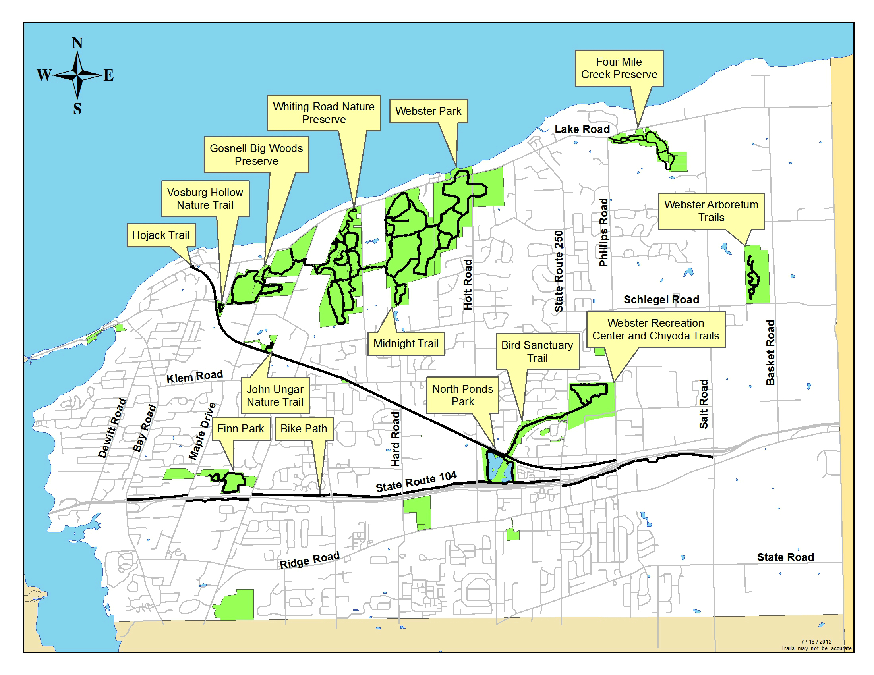
The big picture
You can walk your way across town on Webster’s trails!

Slide 7
An Overview of the Trails maintained by FWT
Whiting Road Nature Preserve (5.85 miles)
Hojack Trail (4.95 miles)
Bird Sanctuary Trail (0.80 miles)
John Ungar Trail (0.30 miles)
Vosburg Hollow (0.35 miles)
Gosnell Big Woods Preserve (2.75 miles)
Four Mile Creek Preserve (2.15 miles)
Finn Park (1.30 miles)
Midnight Trail (0.77 miles)
Chiyoda Trial (0.27) – connects to 1 mile paved loop

Slide 8
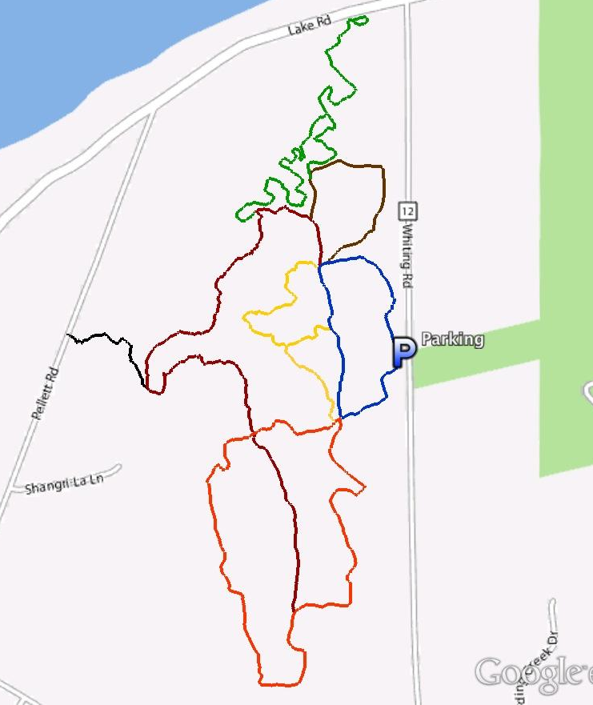
Whiting Road Nature Preserve
240 acres of land purchased by the Town of Webster under the open space referendum
Most popular trail network within the Town of Webster
Connects to Webster Park (to the east) and the Gosnell Big Woods Preserve (to the west)

Slide 9
Hojack Trail
Follows the abandoned Hojack Railroad bed almost 5 miles from Lake Road to Phillips Road
Many shorter trails connect to it

Slide 10
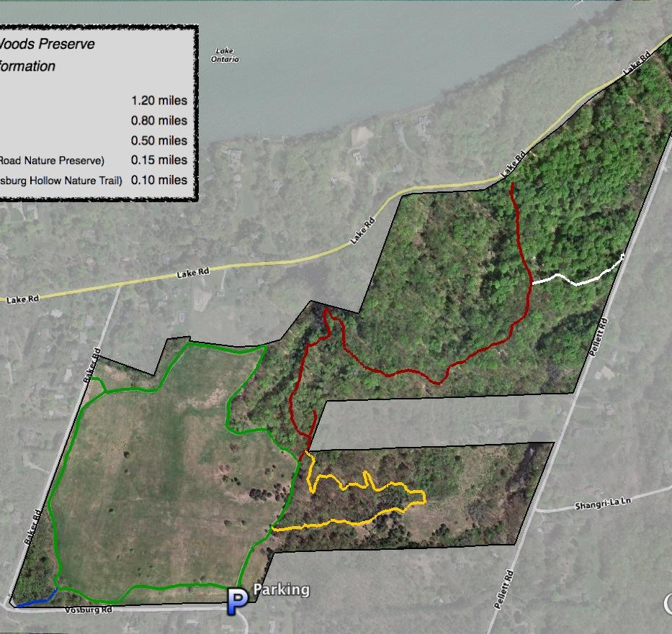
Gosnell Big Woods Preserve
A total of 163 acres consisting of a conservation easement gifted in 2007 by Tom and Georgia Gosnell to the Genesee Land Trust (with the land protect by the easement going to the Town of Webster), and two other parcels sold to the town as part of the open space referendum
The red trail running through an old growth forest, with trees estimated to be up to 350 years old, is a highlight of this property!
Connects to Whiting Road Nature Preserve (to the east), and Vosburg Hollow (southwest corner of the field)

Slide 11
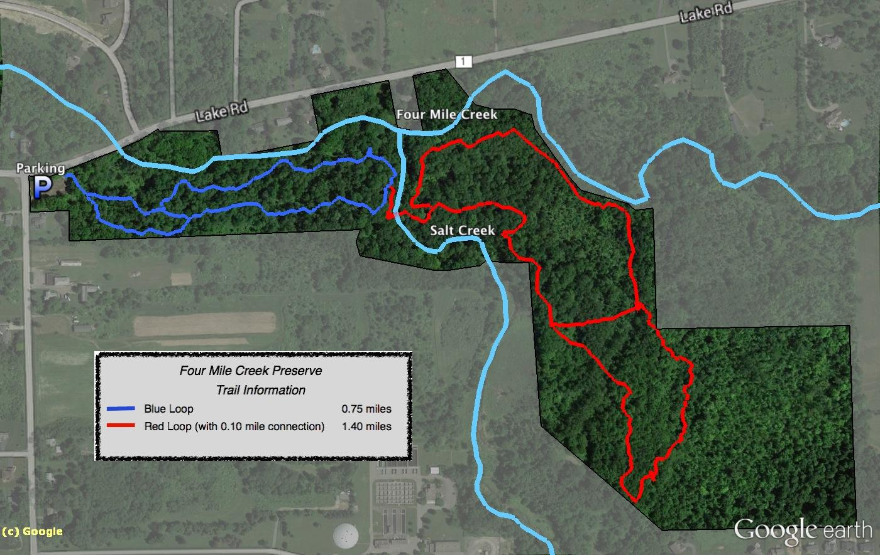
Four Mile Creek Preserve
72 acres of land purchased in 2004 by the Town of Webster under the open space referendum
Features sections of both Four Mile Creek and Salt Creek
A popular fishing spot
Trails and bridges here are the newest addition to the Webster trail network
Additional trail being planned for 2016

Slide 12
Goals for 2016
The FWT board adopted goals for 2016 in support of three main objectives:
Maintaining and improving existing trail networks
Expanding open space areas to underserved areas of the town
Connecting trails, neighborhoods, and community resources

Slide 13
Goals for 2016
Maintain and improve all existing trails through the use of active trail stewards and workdays
Continue efforts to contain invasive species and enhance native habitats
Build a ‘piece’ of new trail (in existing trail systems)
Yellow trail at Four Mile Creek Preserve
Plan a new trail in existing open space with the intent to build it in 2017
Add interest and variety to high use areas (ex: Kiosk content, unique trail features)
Sponsor and support service projects for Scouts and community groups

Slide 14
Goals for 2016
Support the efforts to improve the mapping and blazing of trails at Webster Park
Research grant opportunities and submit a grant in 2016
Increase membership and participation in workdays
Build awareness and network with other town organizations and stakeholders
Engage and nurture our relationship with the planning board
Sponsor five trail/open space events (ex: GBWP 10 year celebration, Hot Cocoa Hike)
Test public support for increasing connectivity by working with a neighborhood to tie it to an existing trail network

Slide 15
How to get involved
Visit our website (www.webstertrails.org)
Follow us on Twitter, Facebook, LinkedIn
Complete a Passport to Wellness (pick up at Rec Center or Wegmans)
Attend an event or our annual meeting
Become an official FWT member
Come to a work party
First work day: 9:00am May 14th at Gosnell Big Woods Preserve
Become a trail steward
Come to a board meeting
Second Monday of the month (7:00pm) at Webster Recreation Center
Just enjoy the trails and tell your friends about them!

Slide 16
Questions?

